Slide 1
Assignment 14.1:Webfolio
Ahmed

Slide 2
Introduction
The topic that I selected for this webfolio assignment is based on analysis of different businesses.
The presentation will cover various elements in relation to these companies. These aspects include:
Customer Value
Customer Satisfaction
Promotion
Socio-cultural forces
Competitive advantage
Technological forces
SWOT ANALYSIS

Slide 3
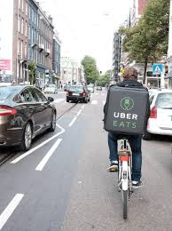
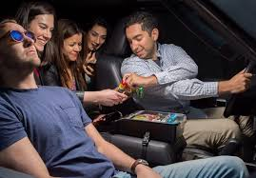
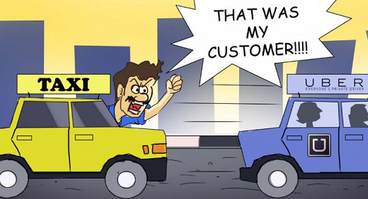
Customer Value in relation to UBER COMPANY
Every business, either small-scale or large-scale, should work towards promoting the value of the goods and services that they provide.
Customers usually buy goods or pay for services as a way of acquiring certain benefits.
The perception of these buyers towards such products matters a lot since it determines their loyalty to the business.
Uber uphold customer value since its services are accompanied by benefits such as positive experience, performance benefit, lower prices, and ease of acquisition.
Uber drivers gives customers an opportunity to choose music and goodies such as candy, water, and phone charging services.
High level of professionalism among Uber driers grants positive experience to consumers.
In terms of performance benefit, Uber is quicker and convenient.
Uber Eats enables customers to acquire goods easily from respective restaurants.
It is easier to hail Uber from any location unlike a taxi that you have to pick on the street.
Notes:
Every business, either small-scale or large-scale, should work towards promoting the value of the goods and services that they provide.
Customers usually buy goods or pay for services as a way of acquiring certain benefits.
The perception of these buyers towards such products matters a lot since it determines their loyalty to the business.
Uber uphold customer value since its services are accompanied by benefits such as positive experience, performance benefit, lower prices, and ease of acquisition.
Uber drivers gives customers an opportunity to choose music and goodies such as candy, water, and phone charging services.
High level of professionalism among Uber driers grants positive experience to consumers.
In terms of performance benefit, Uber is quicker and convenient.
Uber Eats enables customers to acquire goods easily from respective restaurants.
It is easier to hail Uber from any location unlike a taxi that you have to pick on the street.

Slide 4
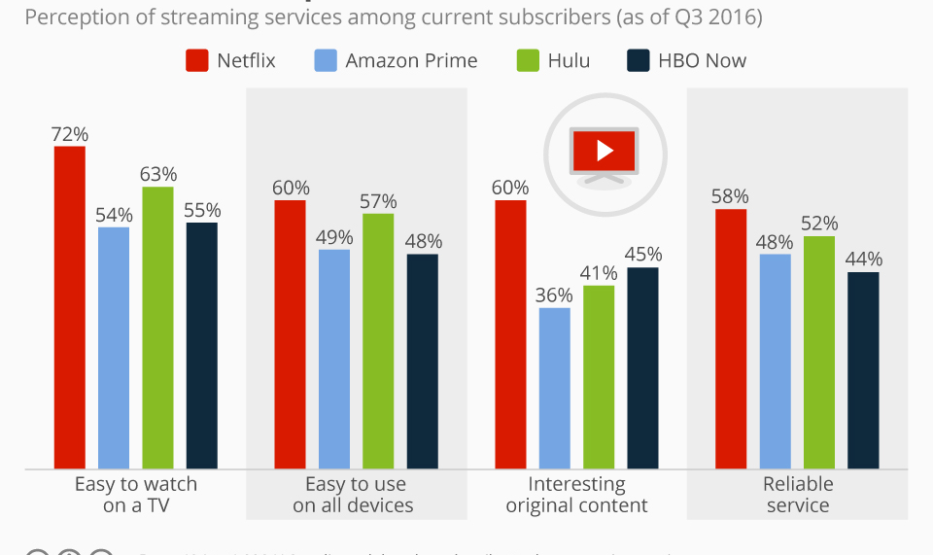
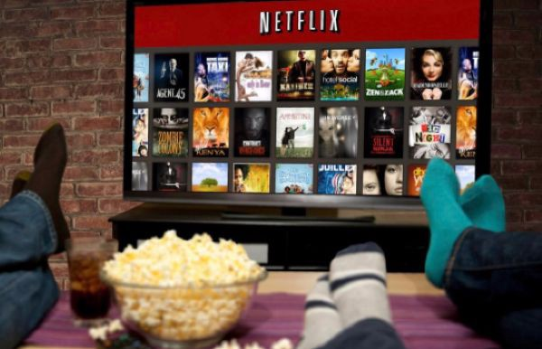
CUSTOMER SATISFACTION
Customers estimate satisfaction by weighing happiness and disappointments that emerge as a result of consuming particular goods and services.
Businesses should prioritize customer’s needs to ensure that they are fully satisfied.
The perception of these buyers towards such products matters a lot since it determines their loyalty to the business.
Netflix has a good record of customer satisfaction since most individuals are happy with its products.
Netflix embrace diversification of movies and categorization in specific and helpful ways.
Netflix provides an individual with an opportunity to share a personal account with friends and family.
Customers are also satisfied with the amazing customer care service.
Effective businesses provide platforms where customers can provide ratings and feedback based on their experiences.
Consumers have the right to provide either negative or negative feedback without any form of coercion.
Uber’s rating system is quite appropriate because it helps drivers to improve their services based on collected customer feedback.
Notes:
Customers estimate satisfaction by weighing happiness and disappointments that emerge as a result of consuming particular goods and services.
Businesses should prioritize customer’s needs to ensure that they are fully satisfied.
The perception of these buyers towards such products matters a lot since it determines their loyalty to the business.
Netflix has a good record of customer satisfaction since most individuals are happy with its products.
Netflix embrace diversification of movies and categorization in specific and helpful ways.
Netflix provides an individual with an opportunity to share a personal account with friends and family.
Customers are also satisfied with the amazing customer care service.
Effective businesses provide platforms where customers can provide ratings and feedback based on their experiences.
Consumers have the right to provide either negative or negative feedback without any form of coercion.
Uber’s rating system is quite appropriate because it helps drivers to improve their services based on collected customer feedback.

Slide 5
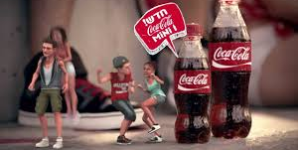
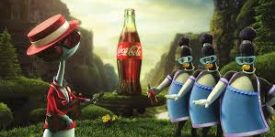
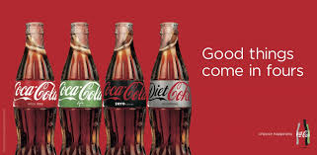
Promotion
Promotion is a vital activity that most businesses integrate as a way of maneuvering the markets.
Promotion creates public awareness, educates people on various features of a product, setting a business apart from its competitors, increase customer traffic, and also build sales and profits.
Coca Cola company has the best promotion technique that has enabled it to increase its market shares.
Coca Cola integrates advertisement as an approach to promote its brands in the market.
Taste and Feeling campaign that Coca Cola launched in 2016 promotes its brands.
Coca Cola utilizes social media platforms to promote its products.
Notes:
Promotion is a vital activity that most businesses integrate as a way of maneuvering the markets.
Promotion creates public awareness, educates people on various features of a product, setting a business apart from its competitors, increase customer traffic, and also build sales and profits.
Coca Cola company has the best promotion technique that has enabled it to increase its market shares.
Coca Cola integrates advertisement as an approach to promote its brands in the market.
Taste and Feeling campaign that Coca Cola launched in 2016 promotes its brands.
Coca Cola utilizes social media platforms to promote its products.

Slide 6
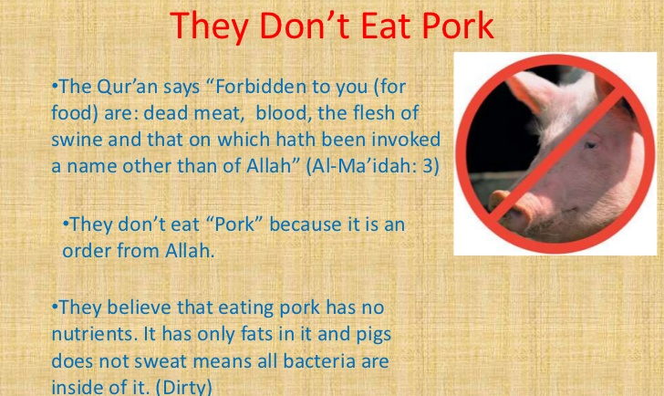
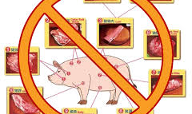
SOCIOCULTURAL FORCES
Sociocultural issues impacts business operations
Attitudes, beliefs, norms, and lifestyles are fundamental elements that determine the success of any good or service in the market.
Islamic culture affects marketing of Pork products.
Consumption of pork is prohibited in Islamic culture because the pig and its flesh are represented as a taboo.
Muslims also regard the pig as unclean hence it is a sin to consume the unclean product.
Failure to assess such Islamic beliefs can lead to business failure.
Notes:
Sociocultural issues impacts business operations
Attitudes, beliefs, norms, and lifestyles are fundamental elements that determine the success of any good or service in the market.
Islamic culture affects marketing of Pork products.
Consumption of pork is prohibited in Islamic culture because the pig and its flesh are represented as a taboo.
Muslims also regard the pig as unclean hence it is a sin to consume the unclean product.
Failure to assess such Islamic beliefs can lead to business failure.

Slide 7
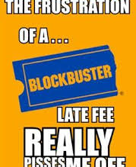
COMPETITION AND SOURCES OF COMPETITIVE ADVANTAGE
Competition prevails in every sector of the economy.
Businesses compete with the aim of maximizing their profitability index and becoming the best organizations.
Entertainment industry constitutes stiff competitors such as Netflix, Blockbuster, and Redbox.
Competition between Netflix and Blockbuster was regarded as extreme because Blockbuster failed to retain its market powers.
Netflix adopted various forms of operation excellence to gain its competitive advantage.
Netflix incorporated massive innovation, larger economies of scale, and also, a broader scope.
Blockbuster failed due to poor leadership and increased cost of services such as administration of late fees.
Uber and taxi are also stiff competitors in transport sector.
Uber has a higher competitive advantage unlike Taxi and other market operators.
Uber’s source of competitive advantage include brand reputation, stronger connection, and outstanding technology.
Notes:
Competition prevails in every sector of the economy.
Businesses compete with the aim of maximizing their profitability index and becoming the best organizations.
Entertainment industry constitutes stiff competitors such as Netflix, Blockbuster, and Redbox.
Competition between Netflix and Blockbuster was regarded as extreme because Blockbuster failed to retain its market powers.
Netflix adopted various forms of operation excellence to gain its competitive advantage.
Netflix incorporated massive innovation, larger economies of scale, and also, a broader scope.
Blockbuster failed due to poor leadership and increased cost of services such as administration of late fees.
Uber and taxi are also stiff competitors in transport sector.
Uber has a higher competitive advantage unlike Taxi and other market operators.
Uber’s source of competitive advantage include brand reputation, stronger connection, and outstanding technology.

Slide 8
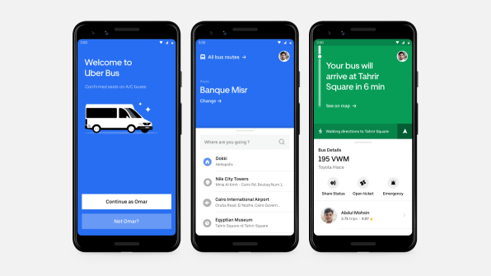
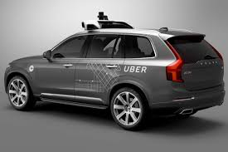
TECHNOLOGICAL FORCES
Advancement of technology has become an advantage and also disadvantage to some organizations.
Netflix's disruptive technology challenged Blockbuster and other market participants.
Uber integrate technology to market its goods and services.
Uber developed a mobile application that connects the drivers and customers.
Technology has also enabled Uber to innovate and apply the concept of self-driving cars.
Notes:
Advancement of technology has become an advantage and also disadvantage to some organizations.
Netflix's disruptive technology challenged Blockbuster and other market participants.
Uber integrate technology to market its goods and services.
Uber developed a mobile application that connects the drivers and customers.
Technology has also enabled Uber to innovate and apply the concept of self-driving cars.

Slide 9
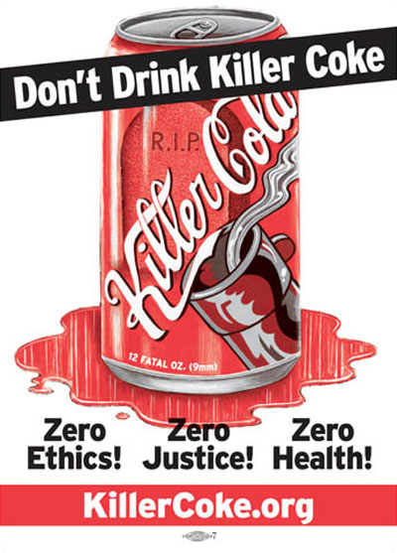
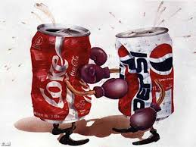
SWOT ANALYSIS
Coca-Cola has the strongest brand identity, a high level of customer loyalty, a dominant market share, the largest brand evaluation that accumulates to 79.96 Billion, and also an extended global reach.
Coca-Cola is facing criticism on how its operations impact health of human beings.
Coca-Cola has opportunities such as capabilities to increase packaged drinking water, increasing its presence in developing nations, and advancing its supply chain system.
Coca Cola experiences stiff competition and packaging controversy.
Notes:
Coca-Cola has the strongest brand identity, a high level of customer loyalty, a dominant market share, the largest brand evaluation that accumulates to 79.96 Billion, and also an extended global reach.
Coca-Cola is facing criticism on how its operations impact health of human beings.
Coca-Cola has opportunities such as capabilities to increase packaged drinking water, increasing its presence in developing nations, and advancing its supply chain system.
Coca Cola experiences stiff competition and packaging controversy.

Slide 10

CONCLUSION

